Slide 1
Arts & Culture Project
February 6, 2019

Slide 2
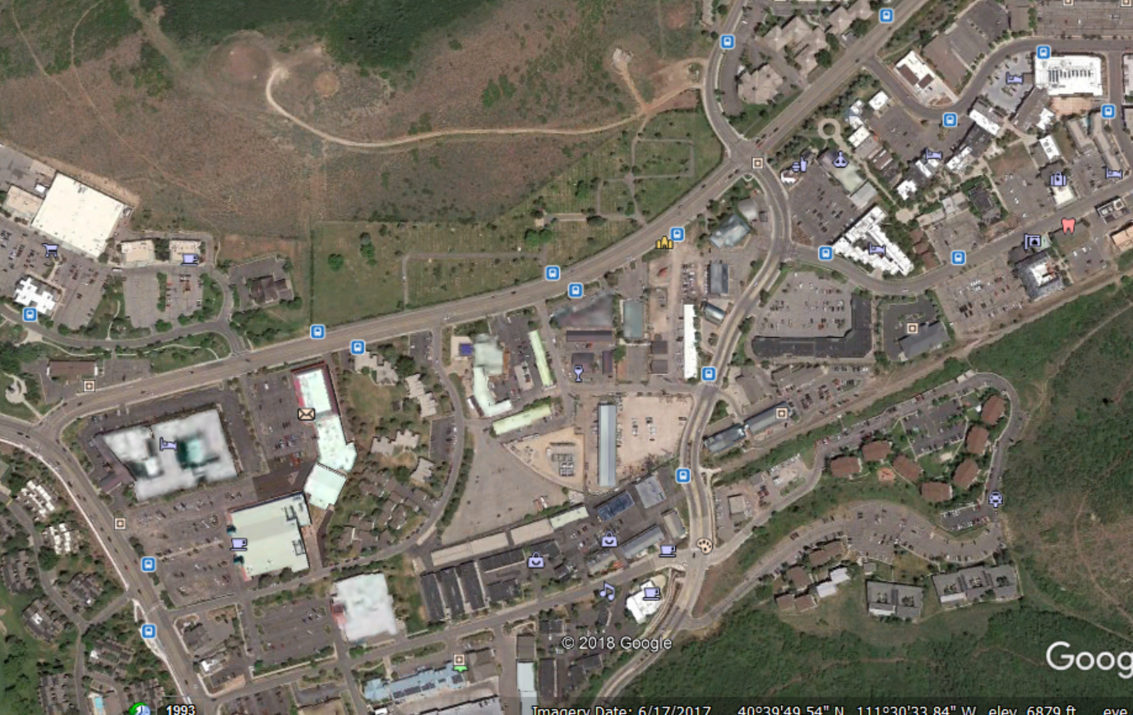

Slide 3
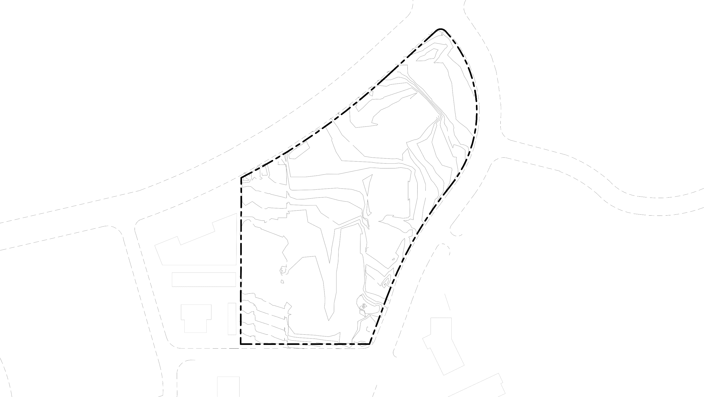
Site Topography
+6797'
+6800'
6800
KEARNS BLVD
+6805'
6
8
0
0
+6800'
6805
+6808'
6808
6809
6
8
0
9
6808
6808
+6808'
6
8
0
5
6809
+6805'
6809
+6810'
⁶⁸10
+6810'
6812
6811
⁶⁸1
0
+6812'
2
1
8
6
6811
6812
+6810'
6₈
¹0
BONANZA DR
6813
6812
6814
+6815'
⁶⁸15
6815
6816
+6817'
+6815
6817
6815
1⁵
₆8
TRUE NORTH
MUNCHKIN RD
+

Slide 4
Electric Utility
ELECTRICAL LINE
(OVERHEAD)
KEARNS BLVD
EXISTING ELECTRICAL LINE (OVERHEAD) PROPOSED ELECTRICAL LINE (UNDERGROUND)
ELECTRICAL LINE (UNDERGROUND)
25' ELECTRIC EASMENT
25'
BONANZA DR
TRUE NORTH
MUNCHKIN RD
+

Slide 5
WORKING Schedule
DESIGN COORDINATION
2019
PHASE 1- DEMO & SITEWORK
2020
PHASE 2 - BUILDINGS
2021 - 2023

