Slide 1


Slide 2
Mountainlands Community Housing Trust
Mission
Create, preserve and advocate for affordable housing
in Summit and Wasatch Counties

Slide 3
Mountainlands Community Housing Trust
New Home Development
single-family/condominium
208 homes, 7 under construction

Slide 4
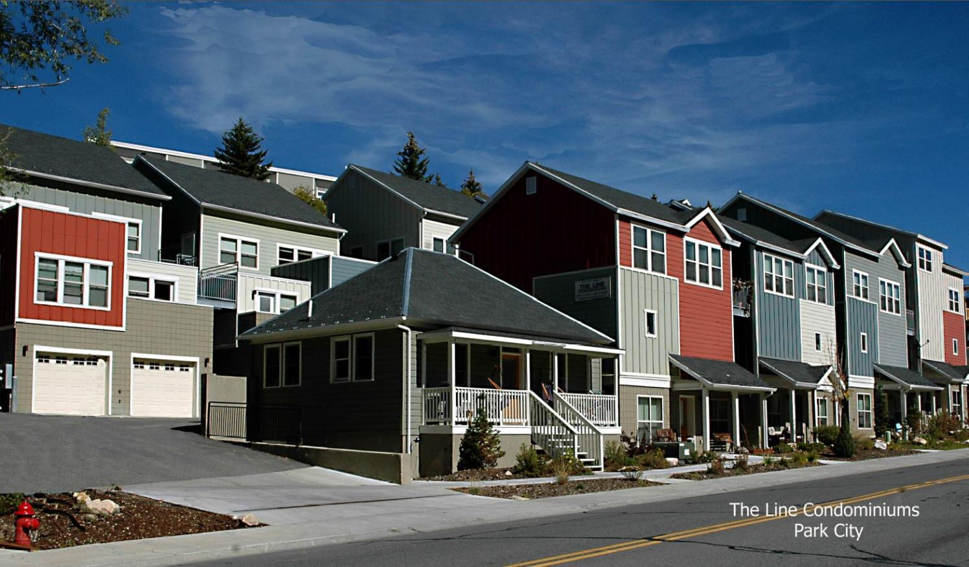
Past Projects

Slide 5
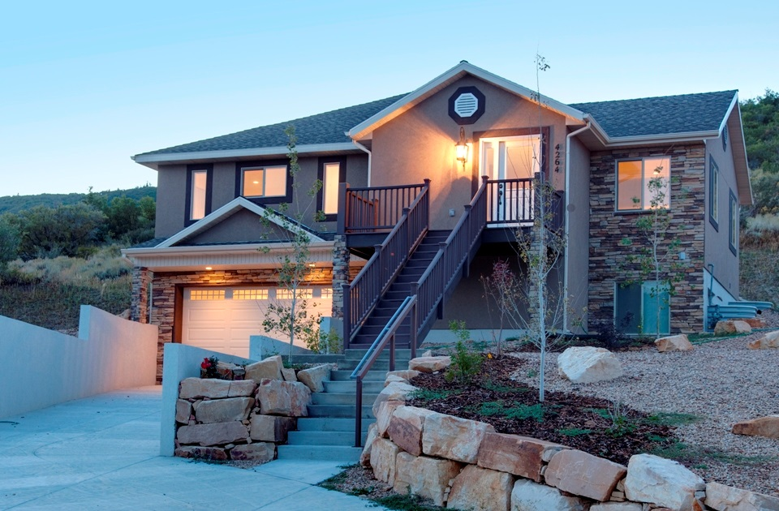
Past Projects
The Woods of Parley’s Lane

Slide 6
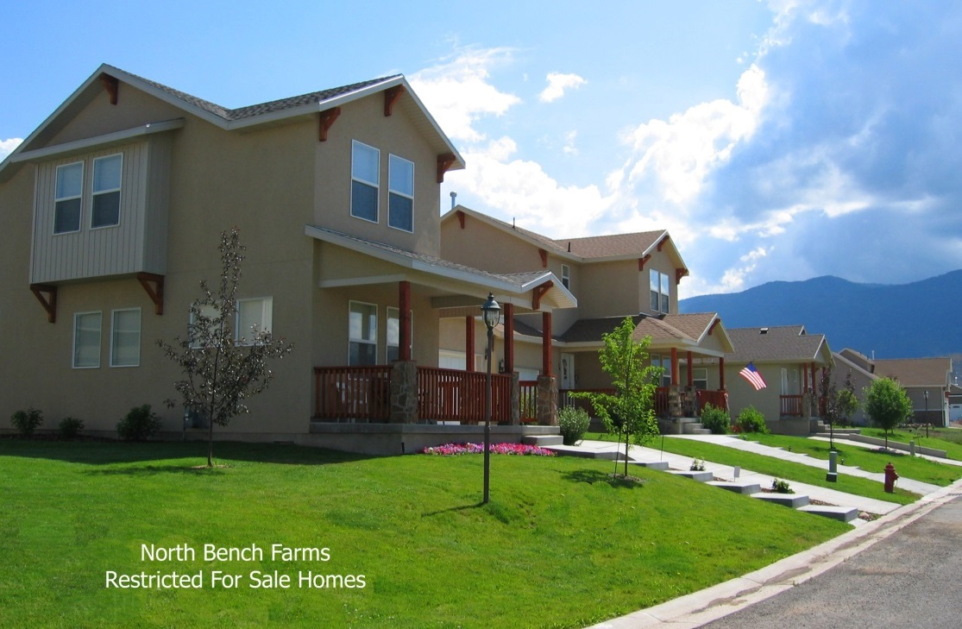
Past Projects

Slide 7
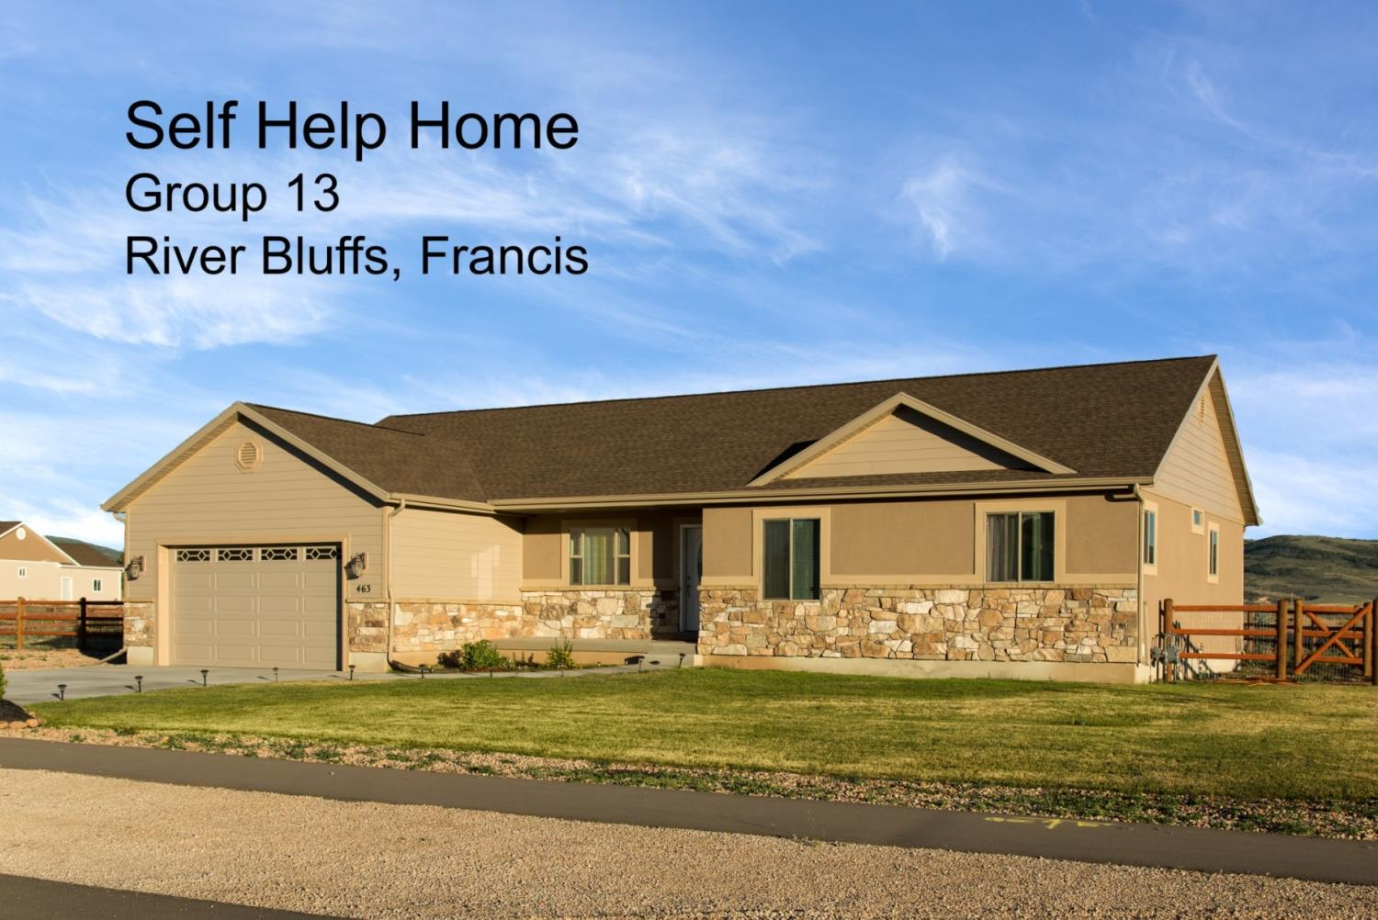
Ongoing Projects
Self-Help Homes

Slide 8
Mountainlands Community Housing Trust
Apartment Development/Management
281 units, 38 under construction

Slide 9
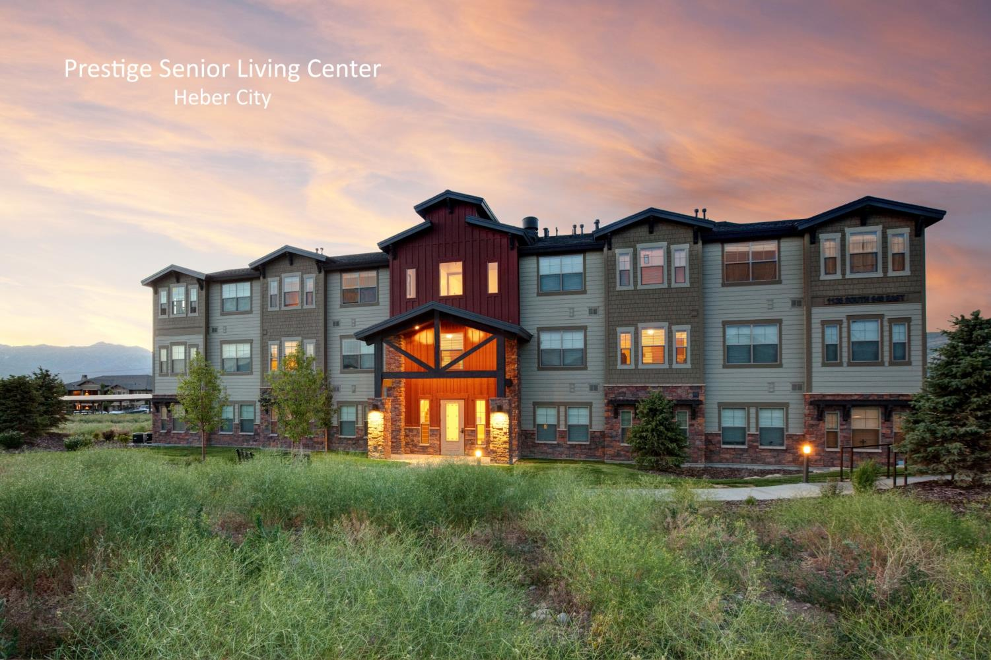
Past Projects

Slide 10
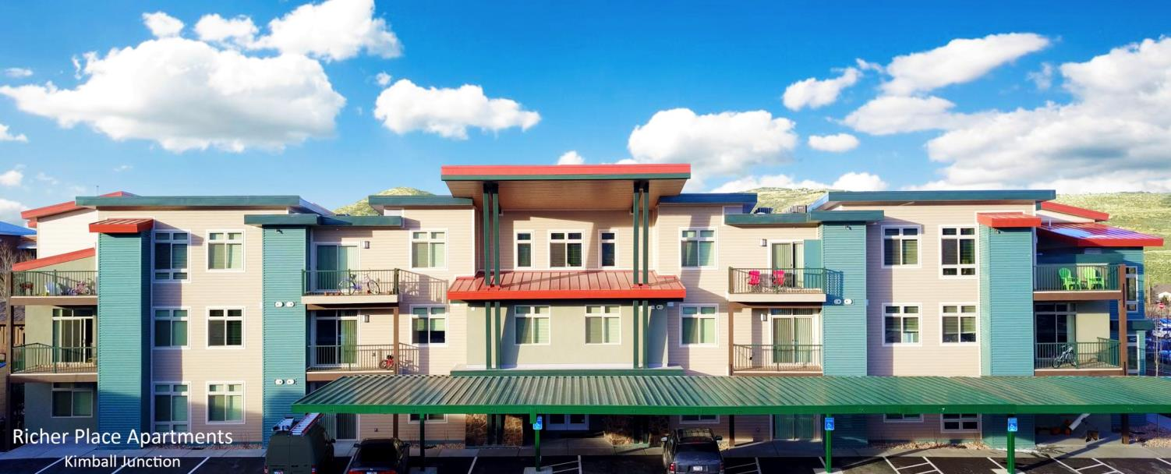
Past Projects

Slide 11
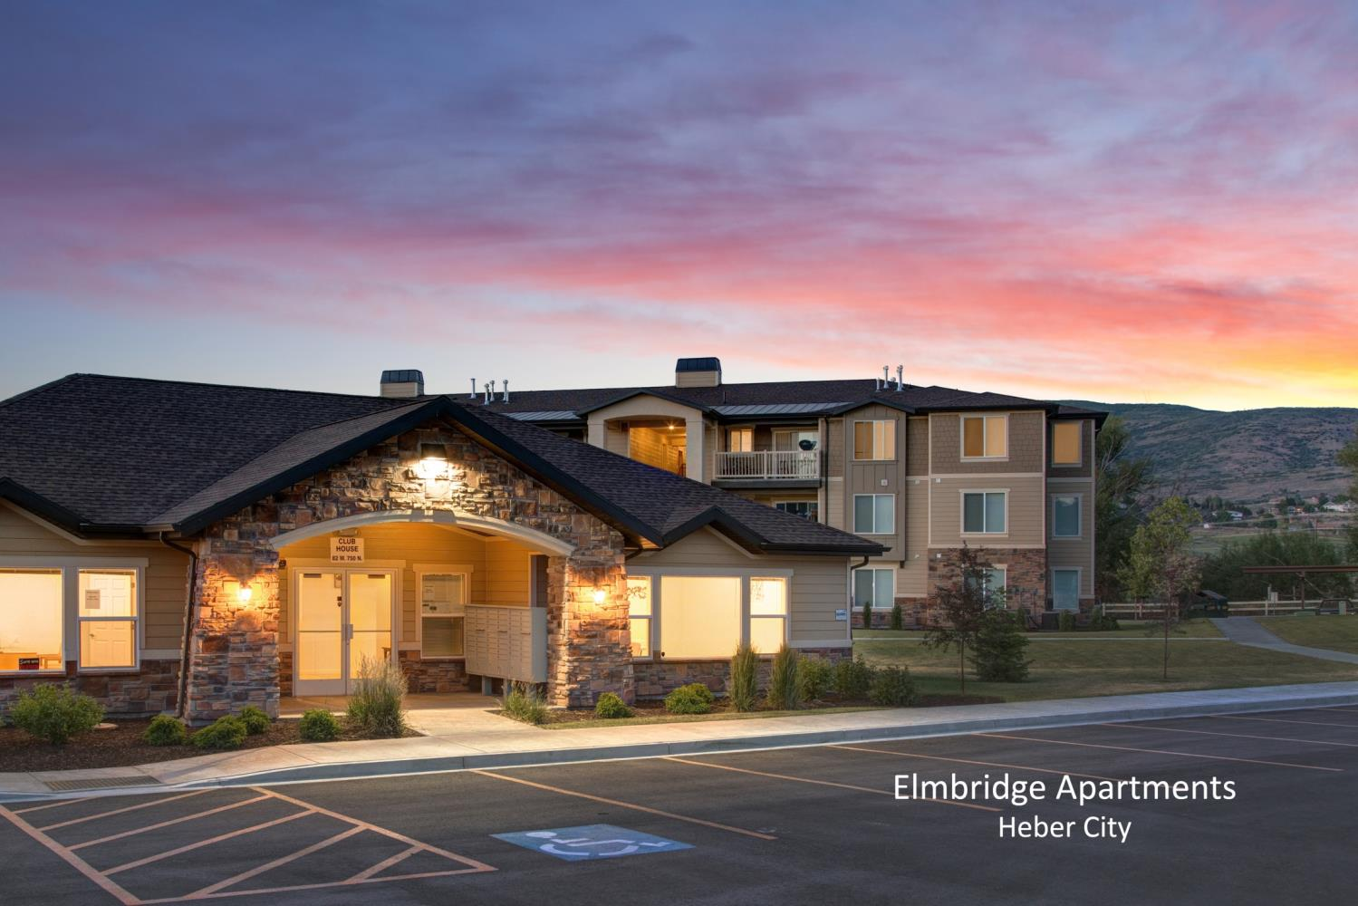
Past Projects

Slide 12
Mountainlands Community Housing Trust
Assist/Partner with
Local Governments
Summit County
Wasatch County
Park City
Kamas City

Slide 13
Mountainlands Community Housing Trust
Housing Resource Center
Assist 3,000 annually

Slide 14
Mountainlands Community Housing Trust
Transitional Housing Program
139 families
343 individuals

Slide 15
Mountainlands Community Housing Trust
Development Pipeline
64 Condominiums (Silver Creek Village)
49 Homes (Heber City)

Slide 16
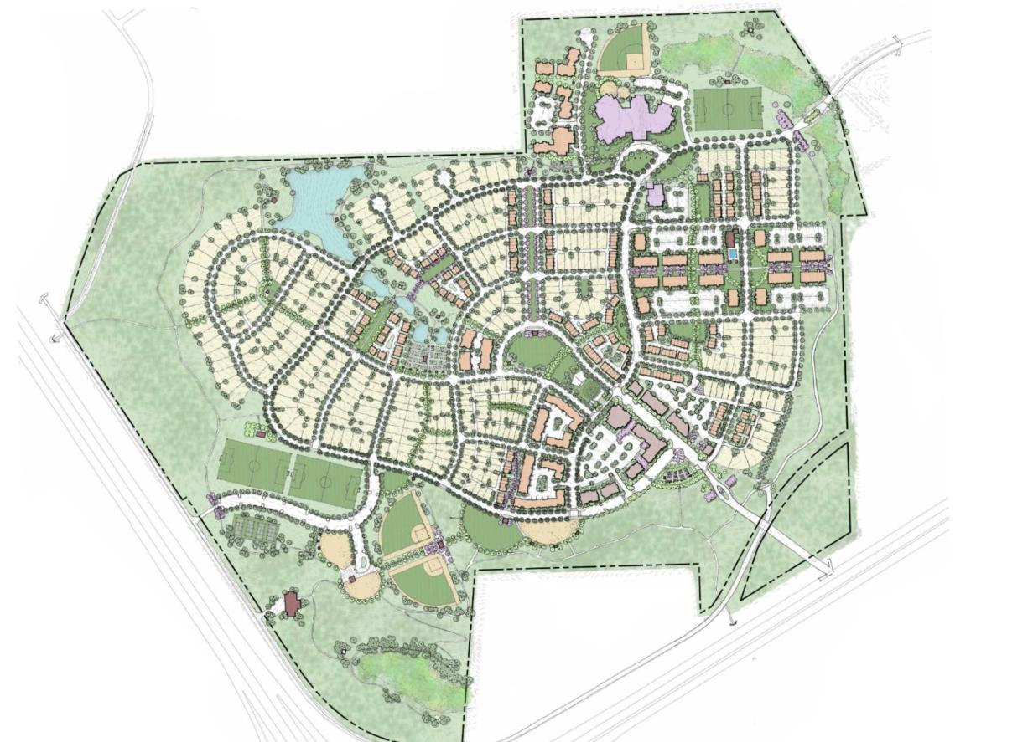

Silver Creek Village
MINERS VILLAGE

Slide 17
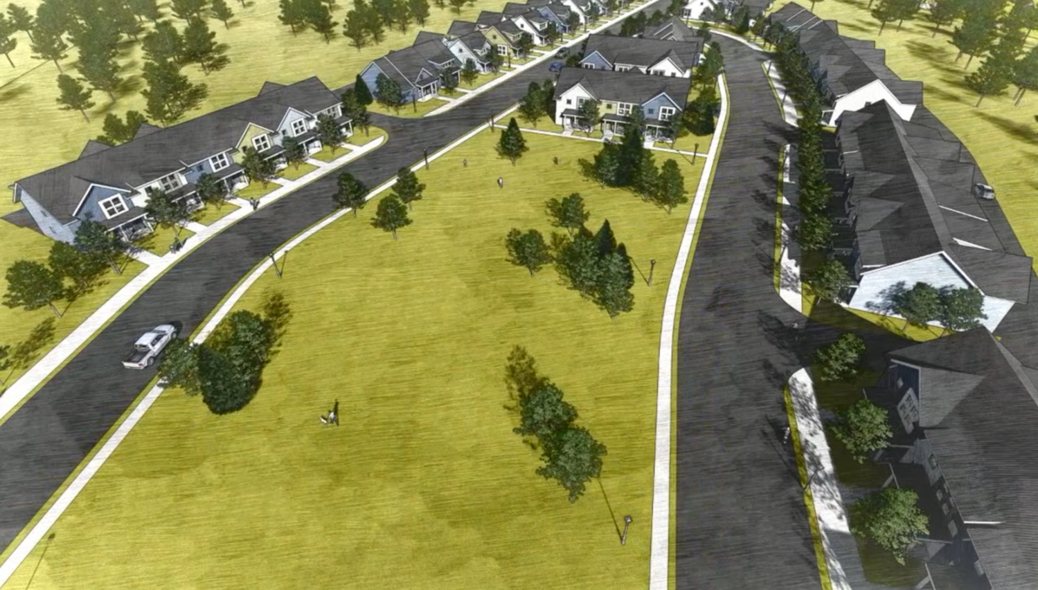

Parkview Place

Slide 18
What is Affordable Housing?
Income Qualified Household
Maximum Sales Price/Rental Rate
Permanent Affordability
Owner Occupied
Workforce Housing?
Targeted to/preferences for local workforce
Notes:
Make appear

Slide 19
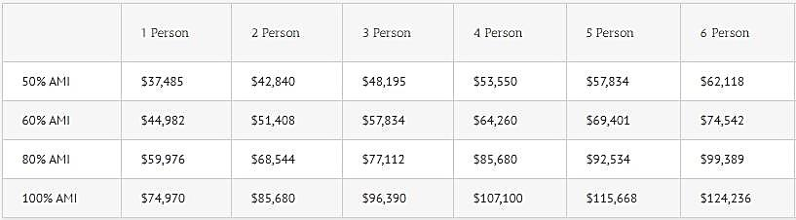
Income Qualified Household
Moderate Income in Summit County
“Moderate income housing“ = household income equal to or less than 80% of the area median income (AMI)
Summit County AMI for a family of four = $107,100
(median: half make more, half make less)

Slide 20
Affordability Gap
Summit County family of four

Slide 21
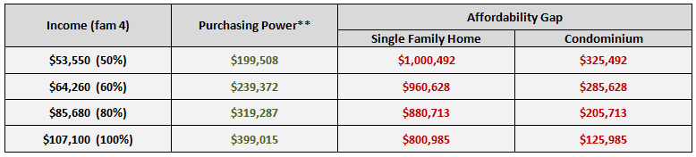
Affordability Gap
Snyderville Basin Median Home Price*
Single Family - $1,200,000
Condominium - $525,000
*Park City Board of Realtors 2018 Q3 Market Report
** Based on 5%, 30 year mortgage, $0 down payment
Notes:
Make the numbers red

Slide 22
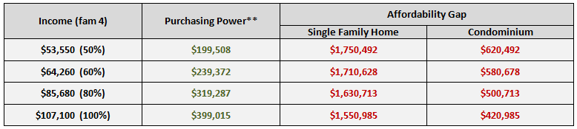
Affordability Gap
Park City Median Home Price*
Single Family - $1,950,000
Condominium - $820,000
*Park City Board of Realtors 2018 Q3 Market Report
** Based on 5%, 30 year mortgage, $0 down payment
Notes:
Make the numbers red

Slide 23
How do I get into affordable housing?
WHERE’S THE ‘LIST’?
Rentals
Waitlists for each rental property
Homeownership
www.housinghelp.org
Join email-list or
pre-apply for homeownership
Self-Help
Contact
Self-Help Coordinator
Projects in Park City?
Contact Park City Municipal

Slide 24


Park City Municipal Corporation
Housing Program
Leadership 101
February 2019

Slide 25
Where are we going?

Slide 26
Making Progress

