Slide 1

Roger Armstrong | County Council Chair Doug Clyde | County Council Vice Chair Tom Fisher | County Manager

Slide 2

Short Introduction to County Government
Form of Government
5 member County Council – All elected at-large
County Manager – Executive and Budget Officer
7 other elected offices
Functions that report to the Manager

Slide 3
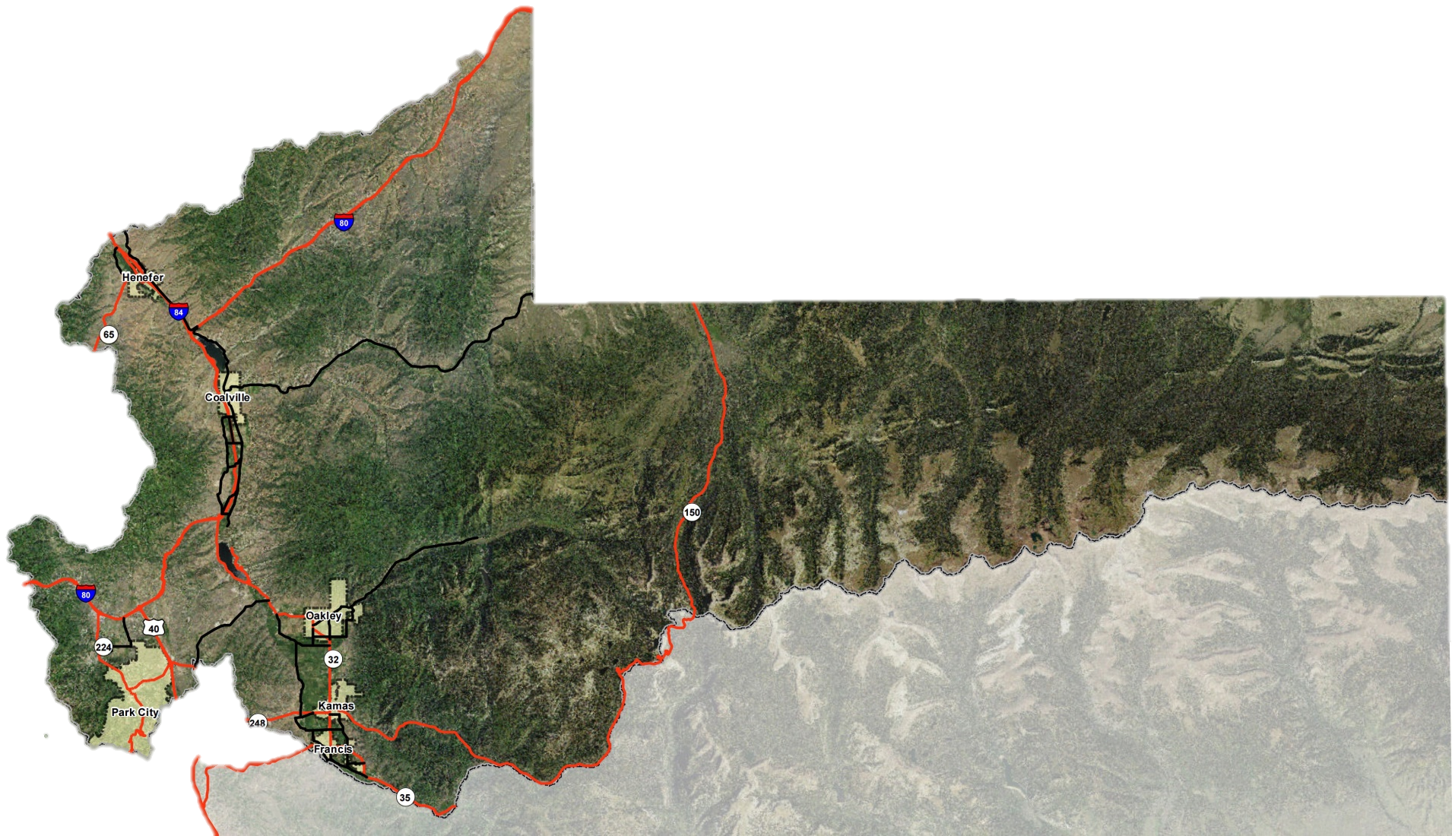
Summit County Cities

Slide 4
Strategic Effects
Transportation and Congestion
Workforce Housing
Environmental Stewardship
Refine County General Plans and Development Codes
Mental Health/Substance Abuse Issues

Slide 5
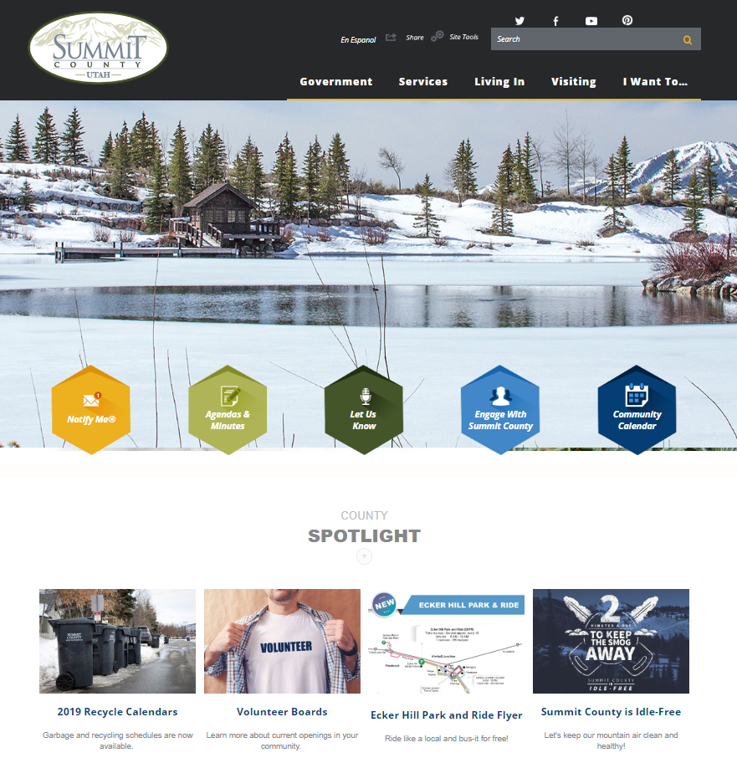
Getting Involved
www.summitcounty.org
5 Priority Buttons
4 Spotlight Events
Notes:
Website has some great features like: personalization function, internal search engine, emergency notification system, and a Google Spanish translation function. Look for a redesign later this year.

Slide 6
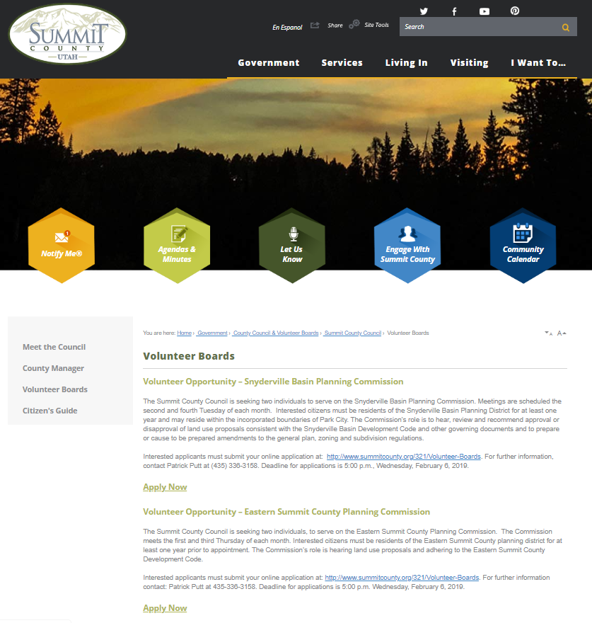
Volunteer Boards
28 boards, districts, committees
Some volunteers appointed by County Manager through consent of the County Council
Some volunteers interviewed and appointed directly by County Council
2-4 year terms
Notes:
Basin Open Space Advisory Committee (BOSAC)
Board of Adjustment
Board of Health
Eastern Summit County Planning Commission (ESCPC)
Eastern Summit County Agriculture Preservation and Open Space Advisory Committee (ESAP)
Eastern Summit Sewer Advisory Committee
Fair Board
Historical Society
Hoytsville Cemetery Maintenance District
Library Board of Directors
Mosquito Abatement District
Mountain Regional Water Special Service District
North Summit Fire Service District
North Summit Special Recreation District
Park City Fire Special Service District
Peoa Recreation Special Service District
Public Arts Program and Advisory Board
Recreation, Arts, and Parks Tax Cultural Committee
Recreation, Arts, and Parks Tax Recreation Committee
Restaurant Tax Advisory Committee
Snyderville Basin Planning Commission
Snyderville Basin Special Recreation District
South Summit Cemetery Maintenance District
State of Utah Summit County Service Area No. 3
State of Utah Summit County Service Area No. 5
Timberline Special Service District
Wanship Cemetery Maintenance District
Weed Control Board

Slide 7
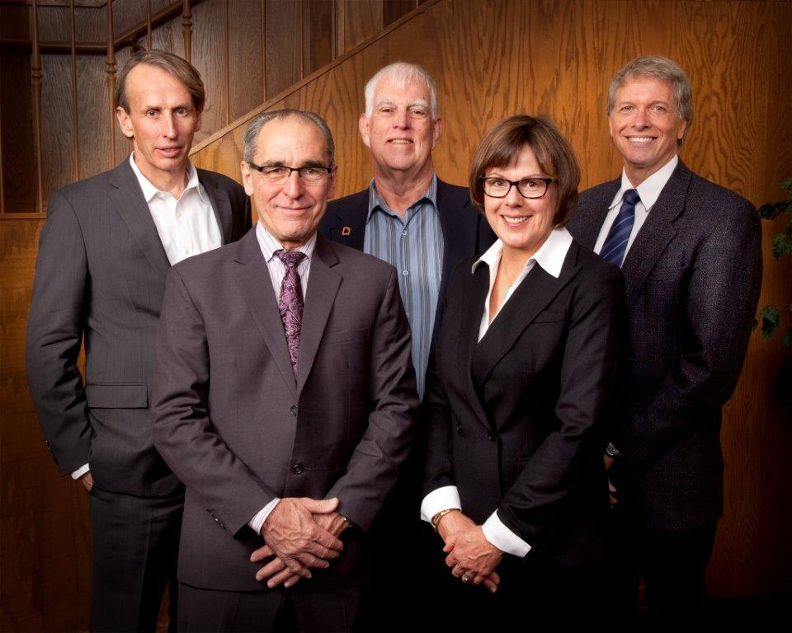






Contact Us
countycouncil@summitcounty.org
countymanager@summitcounty.org
summitcounty.org
Notes:
One of the easiest and most efficient ways for us to communicate with the community is through social media. Summit County has a presence on 6 social media platforms: Facebook, Twitter, Instagram, Nextdoor, YouTube and Pinterest. Our primary focus is on Facebook, Twitter and Instagram but we’re also eager to connect with you through Nextdoor. (The unique thing about using Nextdoor is our PIO can create a post and target a specific neighborhood. She can see all comments shared in the thread to her post, but she can’t see anything else. So your neighborhood conversations stay private.)

