Slide 1
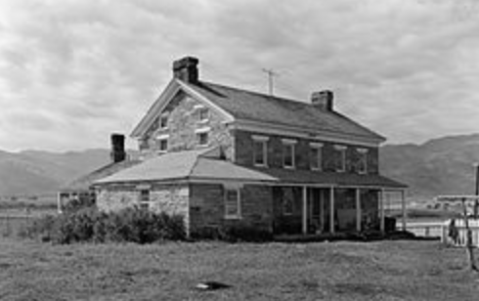
Summit County Planning Leadership 101

Slide 2
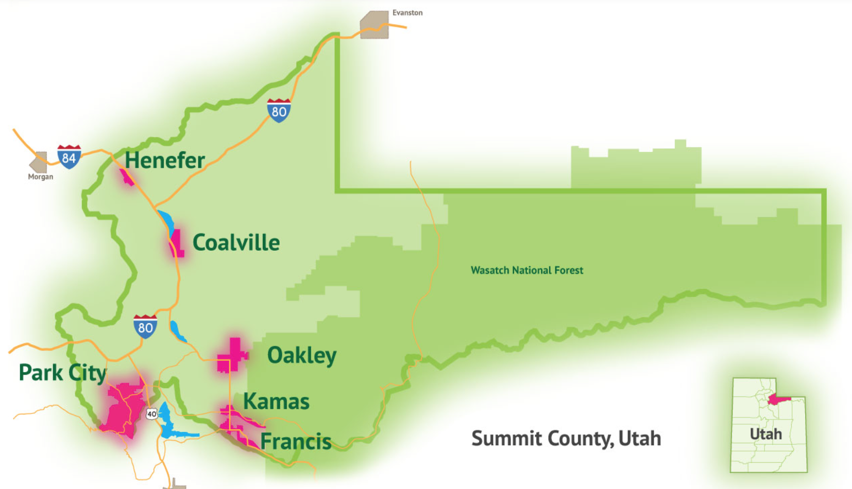
Summit County: The Numbers
1,882 Sq. Miles (Delaware)
6 Municipalities
39,000 Parcels (Unincorporated)
39,000 People
10,000 Dogs*
Left To Be Built
3,900 Vacant S.B. Lots
6M sf Resort
2.5M sf. Commercial

Slide 3
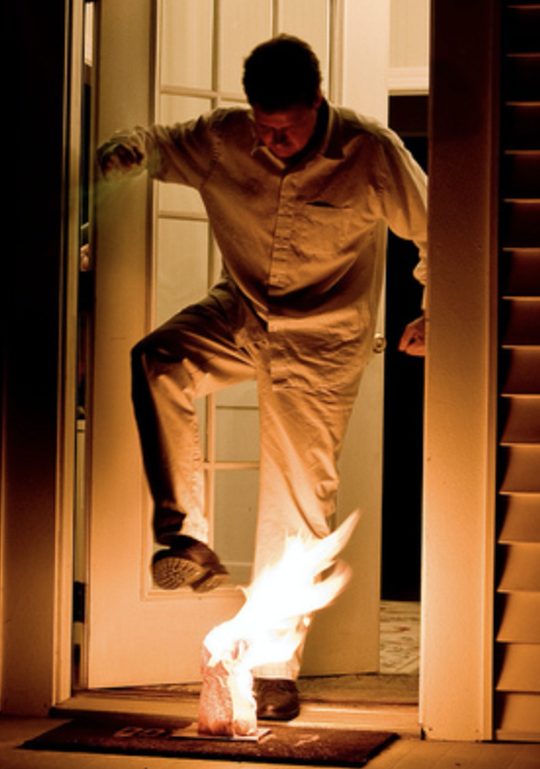
Growth and Change: Proactive vs. Reactive Approaches

Slide 4
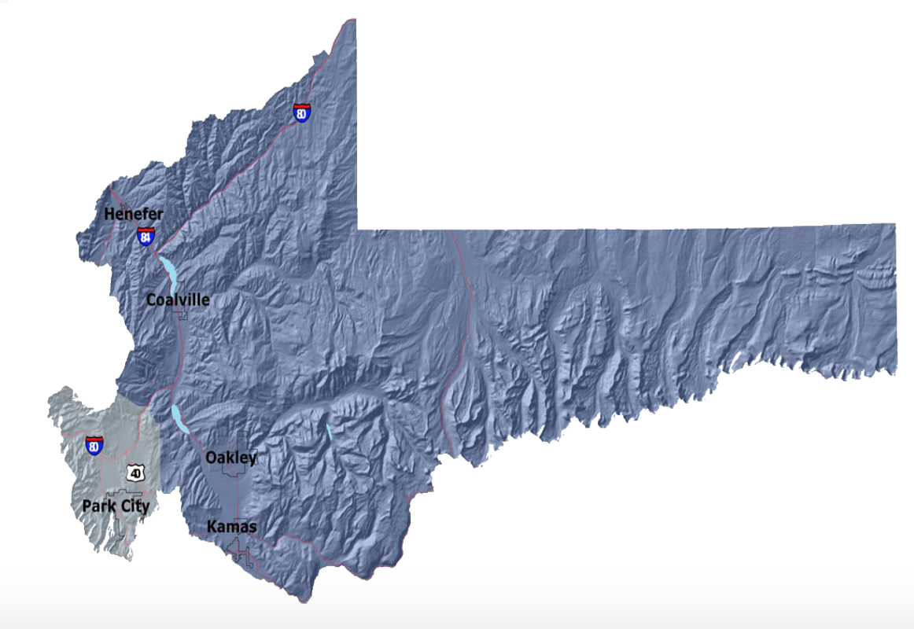
Two Planning Districts. Two Ideas. One Objective.

Slide 5
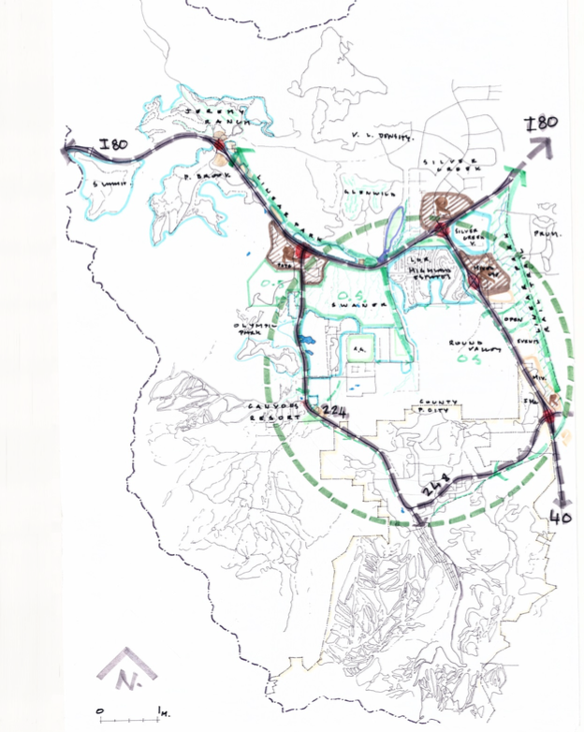
Snyderville Basin: The Idea (Be Known For Our Distinct Neighborhoods and Open Spaces, Not Impressive Roadways)
Complete, Protect, and Enhance Existing Neighborhoods.
Infill Existing Before Filling in the Remaining.
Use Redevelopment as a Tool.
Link neighborhoods through Open Space and Connectivity Corridors.
Manage Growth with Infrastructure and Transportation Choices.
Tolerate the Car, Just Don’t incentivize them.
Kimball Junction Master Plan
Create a Code to Implement These Ideas.

Slide 6
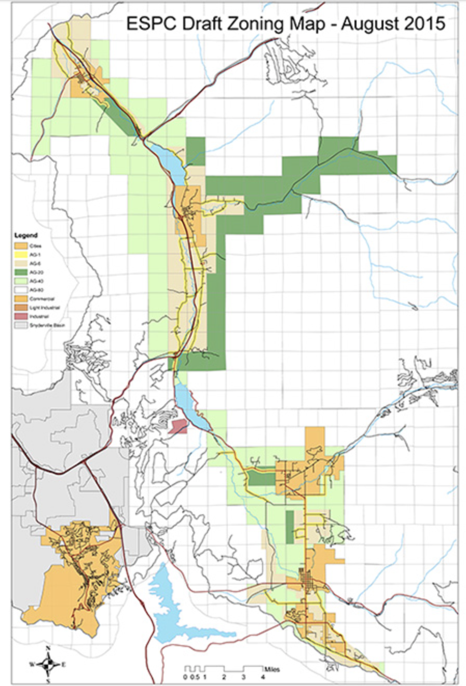
Eastern Summit County: The Idea (Reestablish Community. Recreate Opportunity)
Support Agricultural Heritage But Plan For a Changing Eastside Economy.
Zoning Ordinance & Zoning Map Updates.
Resolved Non-Conforming Parcels Issues.
Created New Zoning Districts
Created Village Overlay Zone
Created Master Planned Development Process
Create Options and Opportunities for Quality Design.
Coordinate with Local Municipalities.
Balance Managing Growth With Private Property Rights (Incentive and Choices).

Slide 7
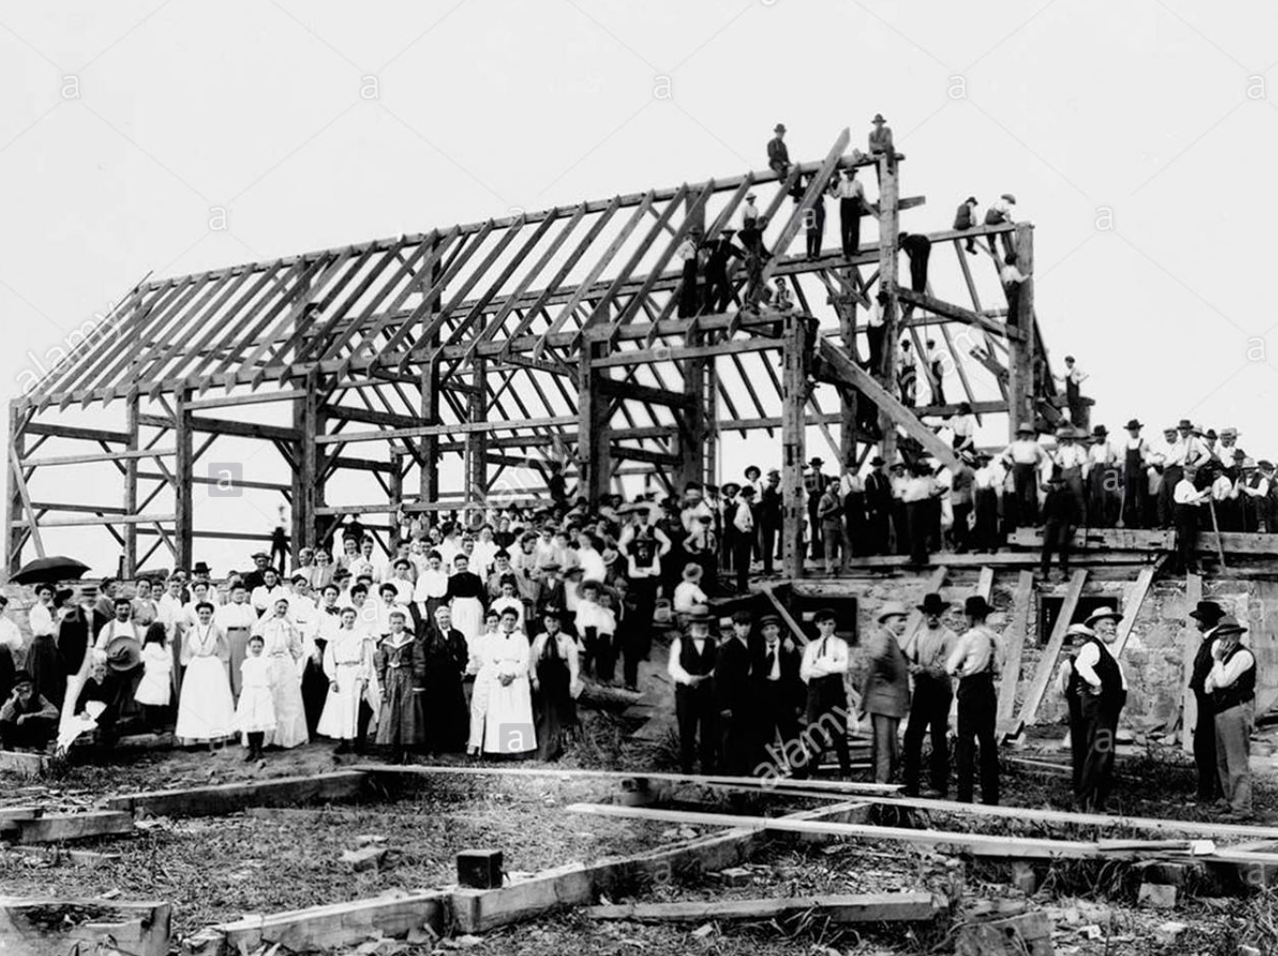
Current Development Projects
Snyderville Basin:
The Canyons, 12 Resort Residential Projects (+/- 700K sf)
Camp Woodward
Discovery (97 Units)
Quarry Springs (68 Units)
Silver Creek Village 150 out of 1290 Units
Eastern Summit County:
Blue Sky:
Event/Conference (59,000 sf)
Equestrian Center (8,500 sf)
Resort Hotel (48,000 sf)
Wellness (7,400 sf)
Distillery Upgrades (35K-300K cases)
Promontory
Nicklaus Clubhouse (17,000 sf)

Slide 8
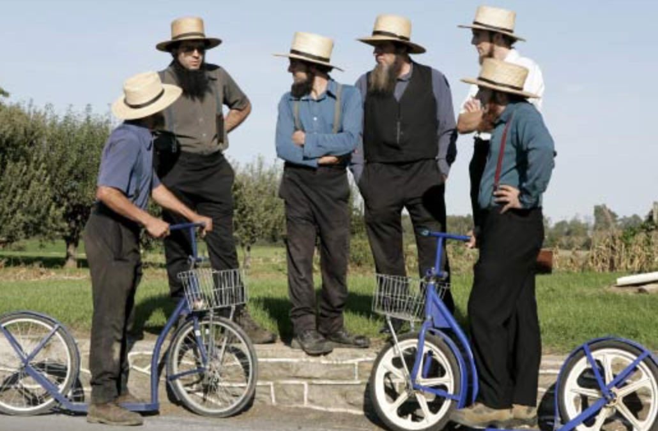
“Intelligence is the Ability to Adapt to Change”
To be successful as a community in the future we will need to:
Cease Fearing Change.
See Change as Opportunity.
“Squeeze-In” a Bit More.
Share our “Space.”
Design Smarter.
Be More Creative.
Move/Transport Ourselves Differently
Accept Occasional Inconvenience.
Think and Act Collectively.
See Ourselves as Living in a Broader, Interconnected Community.

