Slide 1
Glenn Wright | County Council Chair Chris Robinson | County Council Vice Chair Tom Fisher | County Manager
Janna Young | Deputy County Manager

Slide 2
Short Introduction to County Government
Form of Government
5-member County Council – All elected at-large
County Manager – Executive and Budget Officer
7 other elected offices
Assessor, Attorney, Auditor, Clerk, Recorder/Surveyor, Sheriff, Treasurer
Functions that report to the Manager
Notes:
Like to go over the difference between Council/Manager form with Commission form. Have been under this form of government for 13 years. Wasatch County is currently the other County government with this set up.
Then
Property Tax system with Recorder, Auditor, Assessor and Treasurer
Treasurer distributes property tax to all taxing entities, e.g. School Districts, special districts
Clerk handles business licenses, marriage licenses, passports, voter registration and elections
Attorney and Sheriff are the public safety system in the County
Functions that report to Manager: Administration, Public Works, Public Health, Community Development, Transportation Planning, Finance, Human Resources, Information Technology, Facilities, Animal Control and Libraries

Slide 3
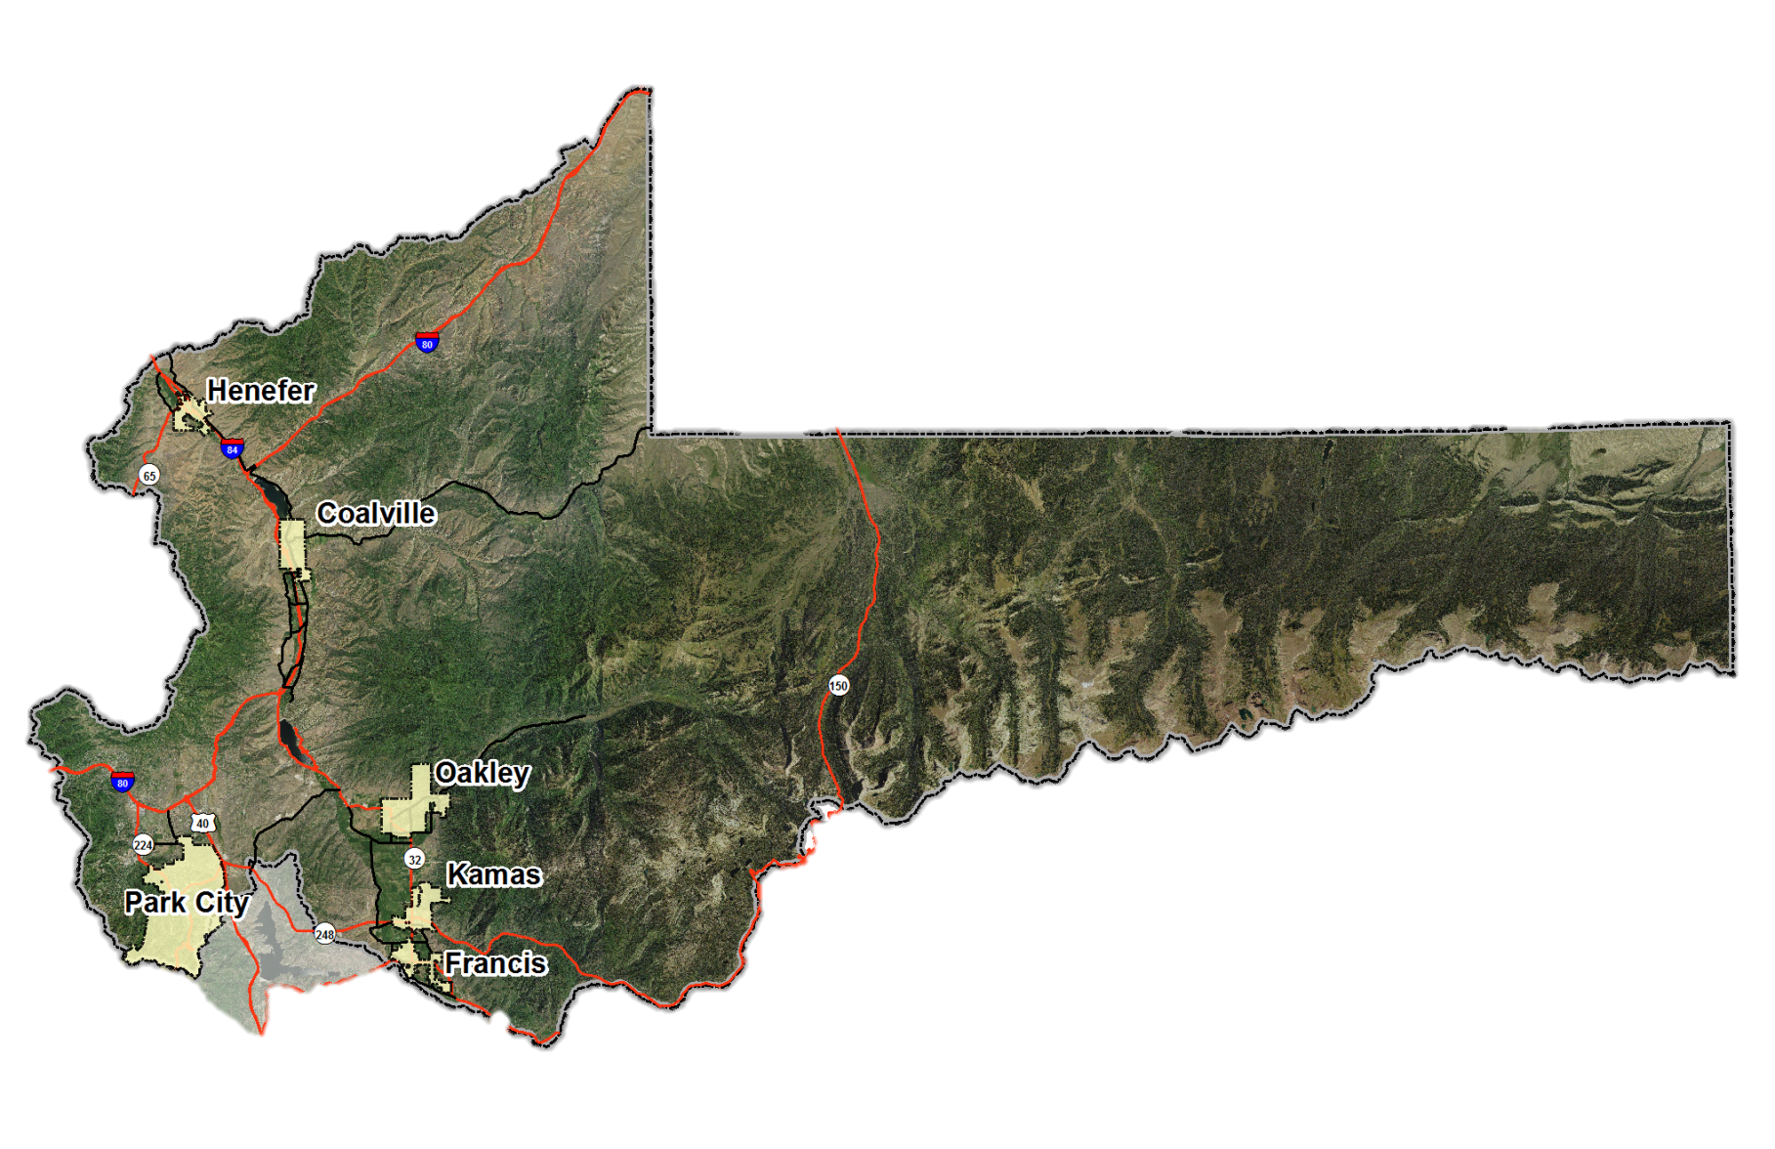
Summit County Cities
Notes:
Orientation to the greater County.
3 school districts
Fire service is provided by 3 districts
EMS is provided under contract with the Park City Fire District to entire county
Sheriff, Fire and EMS cover all the cities in the east, as well as all the National Forest in east County
Size of Rhode Island with:
Approximately 44,000 residents
Can swell by over 100,000 more on any given high tourism weekend in Park City area and Uinta Mountains

Slide 4
Strategic Effects
Transportation, Traffic and Congestion
Workforce Housing
Environmental Stewardship
Refine County General Plans and Development Codes
Mental Health/Substance Abuse Issues
Notes:
Doug: Environmental Stewardship: 2028, 2032 and Greenhouse Gas 2050 Mental Health/Substance Abuse: talk about contract with University of Utah, # of providers we have now vs. then (70 vs. 7)

Slide 5
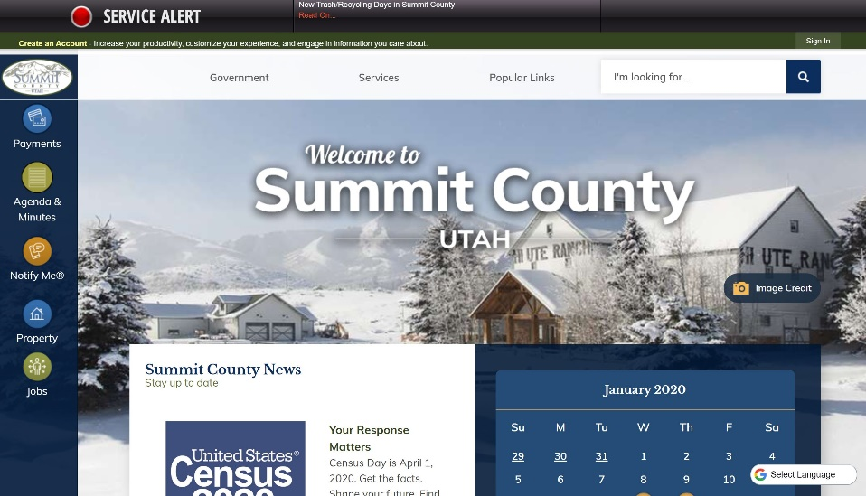
Getting Involved
www.summitcounty.org
5 Priority Buttons
4 Spotlight Events
Notify Me®
County Council Meetings
Public Input
Follow Us on Social Media
Notes:
Website has some great features like: personalization function, internal search engine, emergency notification system, and a Google Spanish translation function. Was redesigned in 2019.
“Notify me” function allows you to be emailed whenever a new agenda is posted for any of the Council meetings, Planning Commissions or any agenda’d function

Slide 6
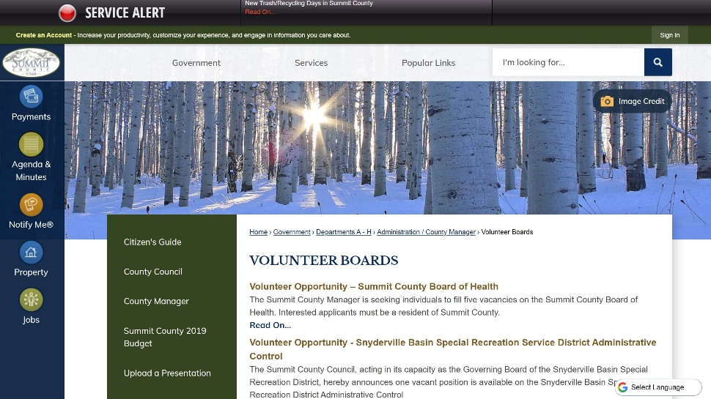
Volunteer Boards
summitcounty.org/321/Volunteer-Boards
29 boards, districts, committees
Some volunteers appointed by County Manager through consent of the County Council
Some volunteers interviewed and appointed directly by County Council
2-4 year terms

Slide 7
So many ways to get involved:
Basin Open Space Advisory Committee (BOSAC)
Board of Adjustment
Board of Health
Eastern Summit County Planning Commission (ESCPC)
Eastern Summit County Agriculture Preservation and Open Space Advisory Committee (ESAP)
Eastern Summit Sewer Advisory Committee
County Fair Advisory Board
High Valley Transit District
Historical Society
Hoytsville Cemetery Maintenance District
Library Board of Directors
Mosquito Abatement District
Mountain Regional Water Special Service District
North Summit Fire Service District
North Summit Special Recreation District
Park City Fire Special Service District
Peoa Recreation Special Service District
Public Arts Program and Advisory Board
Recreation, Arts, and Parks Tax Cultural Committee
Recreation, Arts, and Parks Tax Recreation Committee
Restaurant Tax Advisory Committee
Snyderville Basin Planning Commission
Snyderville Basin Special Recreation District
South Summit Cemetery Maintenance District
State of Utah Summit County Service Area No. 3
State of Utah Summit County Service Area No. 5
Timberline Special Service District
Wanship Cemetery Maintenance District
Weed Control Board

Slide 8
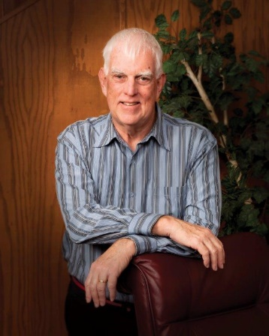
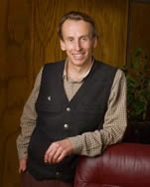
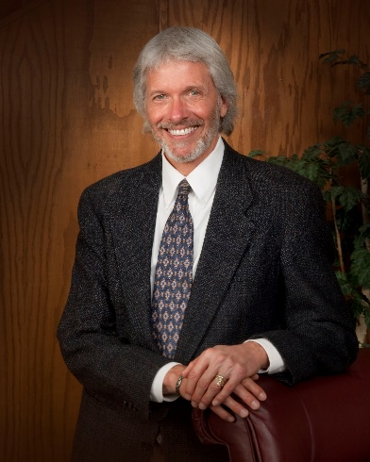
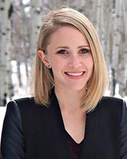
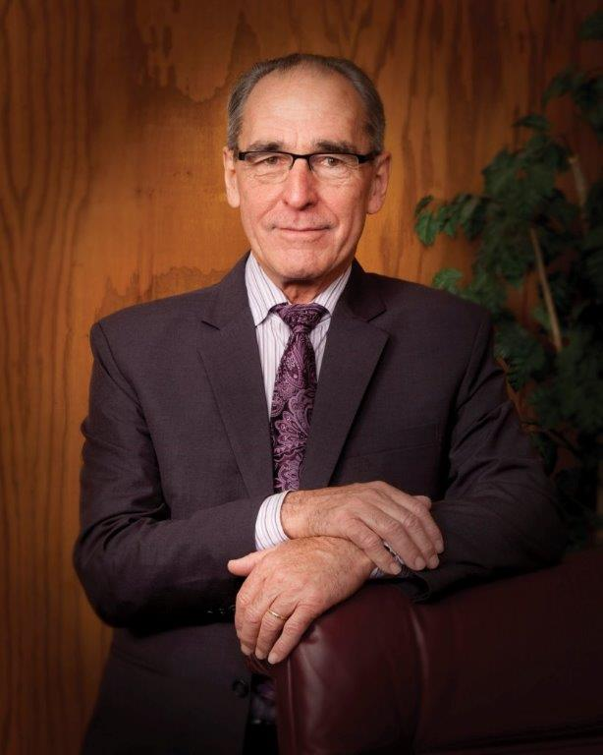
Contact Us
countycouncil@summitcounty.org
countymanager@summitcounty.org
summitcounty.org
Notes:
One of the easiest and most efficient ways for us to communicate with the community is through social media. Summit County has a presence on 6 social media platforms: Facebook, Twitter, Instagram, Nextdoor, YouTube and Pinterest. Our primary focus is on Facebook, Twitter and Instagram but we’re also eager to connect with you through Nextdoor. (The unique thing about using Nextdoor is our PIO can create a post and target a specific neighborhood. She can see all comments shared in the thread to her post, but she can’t see anything else. So your neighborhood conversations stay private.)

